Slide 1
Online Store Sales Data Analysis
Excel Data Analytics project
Annual Sales Report
Dharmindar Ram Linkedin Portfolio Github E-mail

Slide 2
Key Skills practised:
Online Store Sales Data Analysis
Data Cleaning, Feature Engineering, Exploratory Data Analysis, Pivot Table, Pivot Charts, Data Visualisation, Dashboard, Chart Customization
Data Analysis
Business Insights
Dharmindar Ram Linkedin Portfolio Github E-mail

Slide 3
Project Purpose:
Online Store Sales Data Analysis
Dharam Vijay Store’s stakeholder wants to create an annual sales report for 2022. So that, Dharam Vijay can understand their customers and grow more sales in 2023.
Dharmindar Ram Linkedin Portfolio Github E-mail

Slide 4
About Project:
Online Store Sales Data Analysis
This project is about Dharam Vijay Online Store sales data analysis.
The project contains some sample questions to be answered.
Dharmindar Ram Linkedin Portfolio Github E-mail

Slide 5
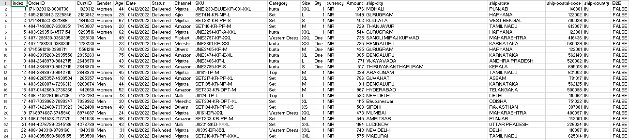
About Data:
Online Store Sales Data Analysis
The raw dataset contains 19 columns and 31048 rows of sales data from Dharam Vijay Store.
Dharmindar Ram Linkedin Portfolio Github E-mail

Slide 6
Approach Used:
Online Store Sales Data Analysis
1. Data Wrangling:-
Performed data cleaning on the given raw data,
Removed inconsistencies,
And looked out for duplicates and null values in each column.
Dharmindar Ram Linkedin Portfolio Github E-mail

Slide 7
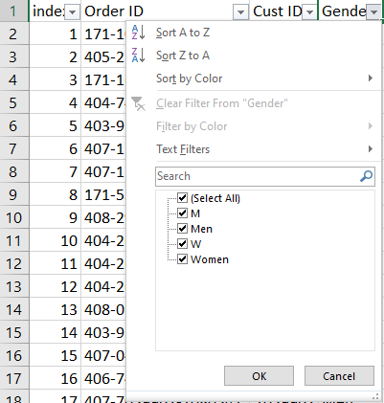
Approach Used:
Online Store Sales Data Analysis
1. Data Wrangling:-
Dharmindar Ram Linkedin Portfolio Github E-mail

Slide 8
Approach Used:
Online Store Sales Data Analysis
2. Feature Engineering:-
It helps to generate new columns with the help of existing ones.
These new columns help to analyze data and find more details.
In this project we created two new columns 'Age Group' and 'Month'.
Dharmindar Ram Linkedin Portfolio Github E-mail

Slide 9
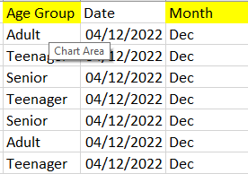
Approach Used:
Online Store Sales Data Analysis
2. Feature Engineering:-
Dharmindar Ram Linkedin Portfolio Github E-mail

Slide 10
Approach Used:
Online Store Sales Data Analysis
3. Exploratory Data Analysis(EDA):-
Exploratory Data Analysis is done to answer the business questions and aim of this project.
Dharmindar Ram Linkedin Portfolio Github E-mail

Slide 11
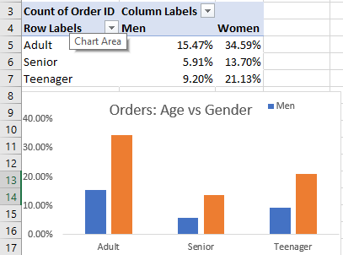
Approach Used:
Online Store Sales Data Analysis
3. Exploratory Data Analysis(EDA):-
Dharmindar Ram Linkedin Portfolio Github E-mail

Slide 12
Approach Used:
Online Store Sales Data Analysis
4. Dashboard Report:-
Finally designed a cutting edge dashboard showing insights and multiple sales trends across different cities.
Dharmindar Ram Linkedin Portfolio Github E-mail

Slide 13
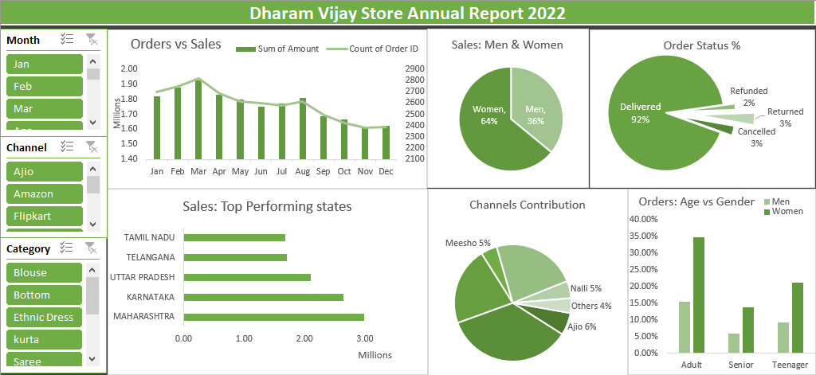
Approach Used:
Online Store Sales Data Analysis
4. Dashboard Report:-
Dharmindar Ram Linkedin Portfolio Github E-mail

Slide 14
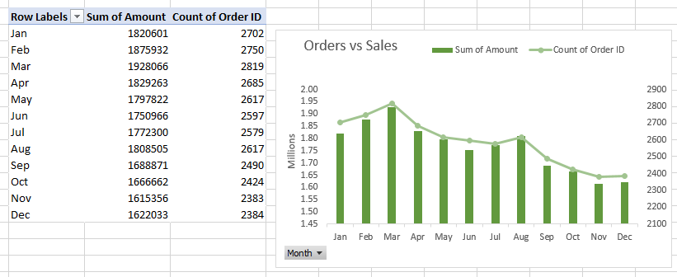
Sample questions:
Online Store Sales Data Analysis
1. Compare the sales and orders using single chart
Dharmindar Ram Linkedin Portfolio Github E-mail

Slide 15
Sample questions:
Online Store Sales Data Analysis
2. Which month got the highest sales and orders?
We can see in table that in March, sales and number of orders are greater than other months.
These greater numbers are clearly visible in the chart in the right hand side.
Dharmindar Ram Linkedin Portfolio Github E-mail

Slide 16
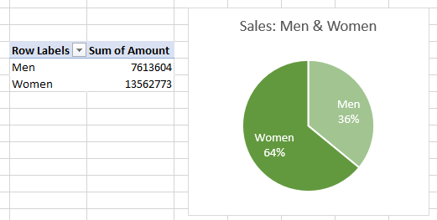
Sample questions:
Online Store Sales Data Analysis
3. Who purchased more, men or women in 2022?
Women(64%) are leading in sales than Men(36%)
Dharmindar Ram Linkedin Portfolio Github E-mail

Slide 17
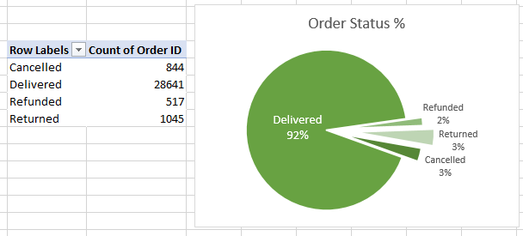
Sample questions:
Online Store Sales Data Analysis
4. What are different order status in 2022?
92% orders are successfully delivered, while 3% orders are returned, 3% are cancelled and other 2% orders are refunded.
Dharmindar Ram Linkedin Portfolio Github E-mail

Slide 18
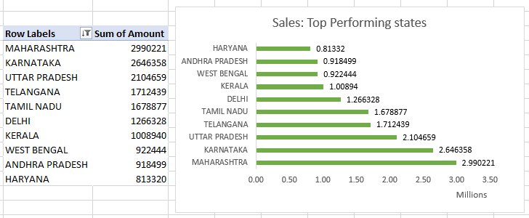
Sample questions:
Online Store Sales Data Analysis
5. List top 10 states contributing to the sales.
Maharashtra is the leading state to the sales having revenue around 2.99 million.
Dharmindar Ram Linkedin Portfolio Github E-mail

Slide 19
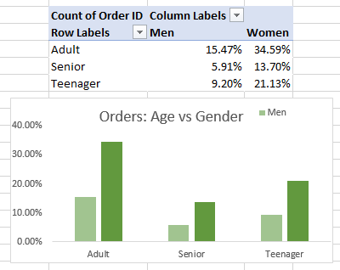
Sample questions:
Online Store Sales Data Analysis
6. Relation between age and gender based on number of orders?
Adult category is leading based on number of orders having more orders by women(34.59%) than men(15.4%)
Dharmindar Ram Linkedin Portfolio Github E-mail

Slide 20
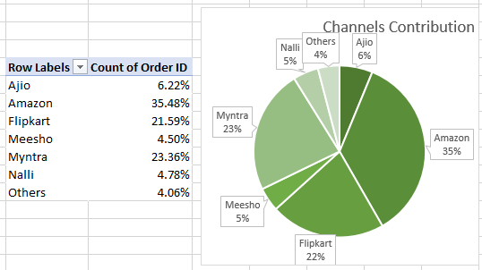
Sample questions:
Online Store Sales Data Analysis
7. Which channel is contributing to maximum sales?
Amazon(35%), Myntra(23%) and Flipkart(22%) are contributing to maximum sales.
Dharmindar Ram Linkedin Portfolio Github E-mail

Slide 21
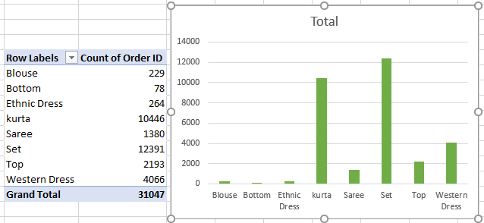
Sample questions:
Online Store Sales Data Analysis
8. Which one is Highest selling category?
Set is the highest selling category having number of orders 12391
Dharmindar Ram Linkedin Portfolio Github E-mail

Slide 22
Project Insights:
Online Store Sales Data Analysis
Women are more likely to buy as compared to Men (~64%)
Maharashtra, Karnataka and Uttar Pradesh are the top 3 states (~35%)
Adult age group (30-49 yrs) are most contributing (~50%)
Amazon, Flipkart and Myntra channels are most contributing (~80%)
Set is the highest selling category available
Dharmindar Ram Linkedin Portfolio Github E-mail

Slide 23
Project Findings:
Online Store Sales Data Analysis
Target Women customers of Age group (30-49 yrs) living in Maharashtra, Karnataka and Uttar Pradesh by showing ads/offers/coupons available on Amazon, Flipkart and Myntra.
Dharmindar Ram Linkedin Portfolio Github E-mail

Slide 24

DHARMINDAR RAM
Data Enthusiast | ML Engineer | Data Analyst
Linkedin Portfolio Github E-mail

